Slide 1
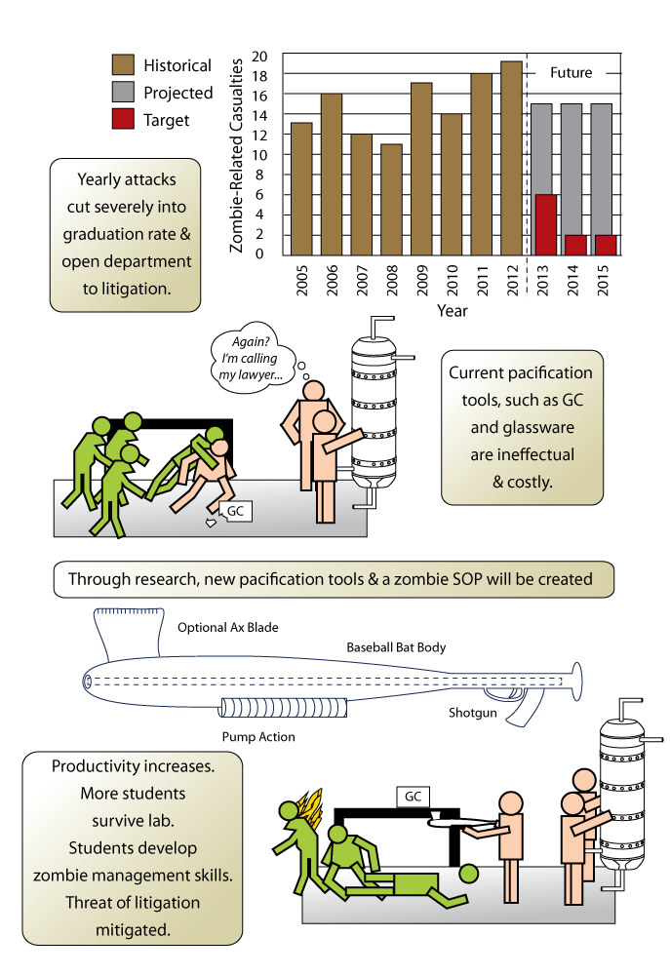
Improved Laboratory Safety through the Development of
Homo Coprophagus Somnambulus Management Tools
Funds $125
Freshmen: 5
Anthony Butterfield
tony.butterfield@utah.edu
Project Summary:
Conduct research on mitigating zombie infestations within our projects laboratory.
Develop new analytical equipment and collect database on zombie properties.
Develop and validate novel zombie pacification devices.
Project Impact:
Remedy one of the top 5 causes of death within our projects laboratory.
Develop a life and cost-saving zombie database, SOP, preparedness kit.
Our students gain marketable undead management skills.
Proposed Targets:
Metric | State of the Art | Proposed Technology
Measurable Zombie Properties | Velocity | Flashpoint Tensile strength Fugacity
Lab deaths attributable to zombie attack | ≈ 14 deaths/yr | < 2 deaths/yr
Lab’s primary zombie pacification device | Glassware, GC, safety showers | Baseball bat / shotgun hybrid
Prevent Deaths, Equipment Damage, & Litigation Resulting from Zombie Apocalypse

Slide 2
Improved Laboratory Safety through the Development of
Homo Coprophagus Somnambulus Management Tools
Funds $125
Freshmen: 5
Vital Project Info
Descriptive Project Title
Anthony Butterfield
tony.butterfield@utah.edu
Project Summary:
Conduct research on mitigating zombie infestations within our projects laboratory.
Develop new analytical equipment and collect database on zombie properties.
Develop and validate novel zombie pacification devices.
Short description of entire proposed project
Project Impact:
Remedy one of the top 5 causes of death within our projects laboratory.
Develop a life and cost-saving zombie database, SOP, preparedness kit.
Our students gain marketable undead management skills.
Short description of what audience will get for their support.
Right half left for easy-to-digest visual depiction of work.
Proposed Targets:
Metric | State of the Art | Proposed Technology
Measurable Zombie Properties | Velocity | Flashpoint Tensile strength Fugacity
Lab deaths attributable to zombie attack | ≈ 14 deaths/yr | < 2 deaths/yr
Lab’s primary zombie pacification device | Glassware, GC, safety showers | Baseball bat / shotgun hybrid
Measurable, quantifiable outcomes.
Short central idea of the work
Prevent Deaths, Equipment Damage, & Litigation Resulting from Zombie Apocalypse

