Slide 1
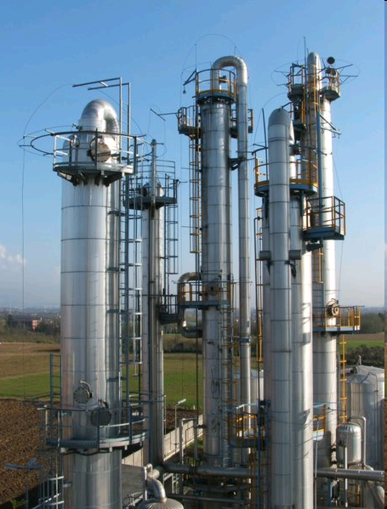
Distillation in Design
Terry A. Ring
ChE
University of Utah
www.che.utah.edu/~ring

Slide 2
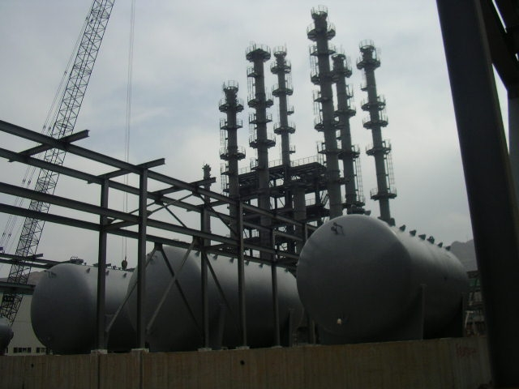

Slide 3
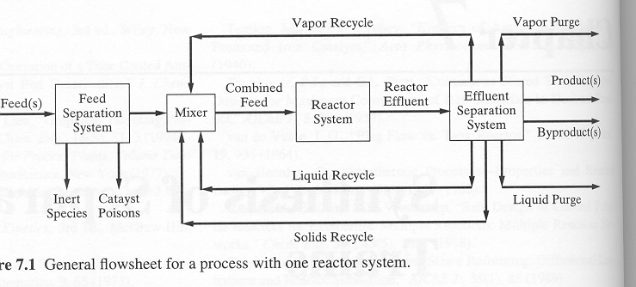
Use of Separation Units

Slide 4
Criteria for the Selection of a Separation Method
Energy Separation Agent (ESA)
  Phase condition of feed
  Separation Factor
  Cost
Mass Separation Agent (MSA)
  Phase condition of feed
  Choice of MSA Additive
  Separation Factor
  Regeneration of MSA
  Cost
Phases I and II,
Components 1 and 2 (light key and heavy key)
Notes:
MSA
Benzene to break ethanol water azeotrope
Kerosene to remove organics from water – LL decantation
Add non solvent to cause crystallization

Slide 5
Distillation

Slide 6
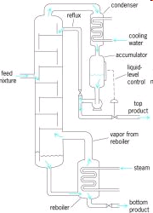
Distillation
Notes:
Add extra Tanks and control system for liquid level

Slide 7
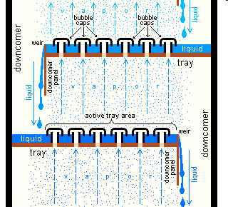
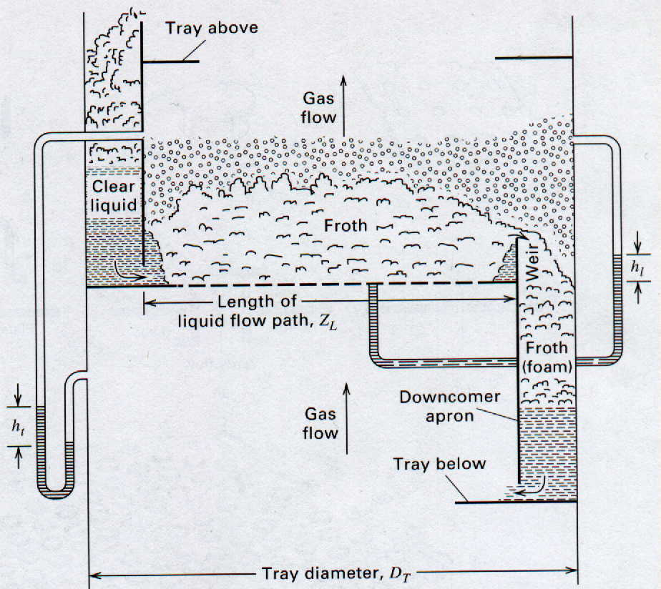
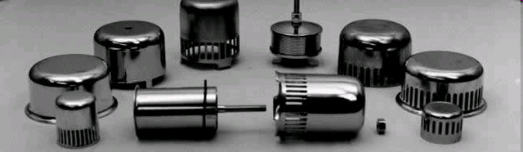
Plate Types
Bubble Cap Tray
Sieve Tray

Slide 8

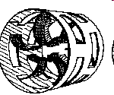
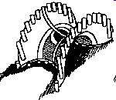
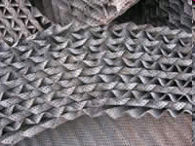
Packed Towers
Random Packing
Structured Packing
Note: Importance of
Distributor plate

Slide 9


Distillation
α=K_{L}/K_{H}
Relative Volatility
Equilibrium Line

Slide 10






Distillation
Rectifying Section
  R= reflux ratio
  V=vapor flow rate
Stripping Section
  V_{B}= Boil-up ratio
Feed Line

Slide 11

Minimum Reflux Ratio

Slide 12
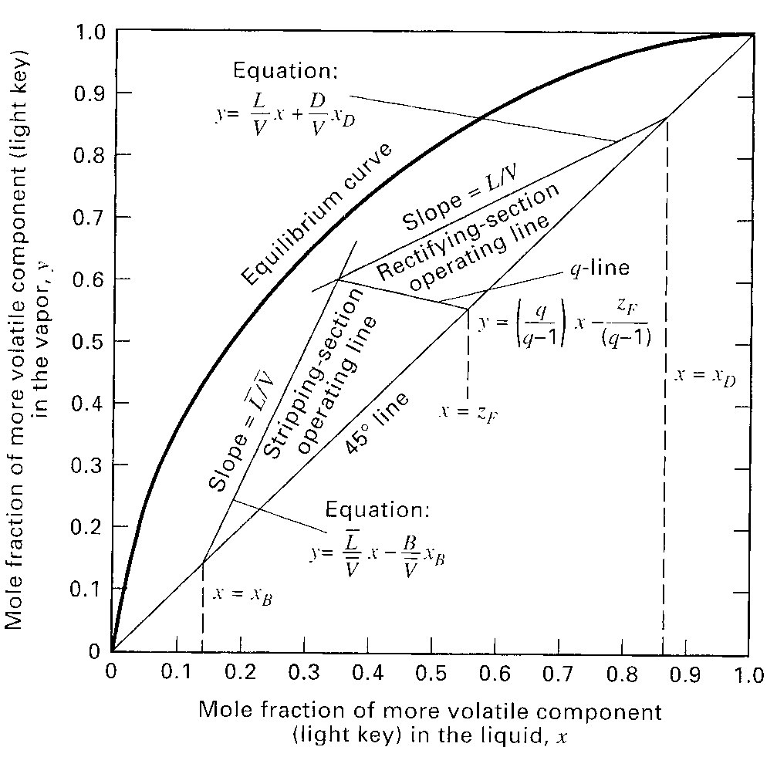
McCabe-Thiele

Slide 13
Step Off Equilibrium Trays

Slide 14
What are you going to learn next year?
Column sizing
  Diameter of Column
  Size of trays
  Height of packing
Column Costing
Optimization of column with respect to cost to run (capital cost and operating cost)
How to develop a distillation train.
How to set up side streams in multi-component distillation.

Slide 15
Marginal Vapor Rate
Annualized Cost~ Marginal Vapor Rate
Annualized Cost proportional to
  Reboiler Duty (Operating Cost)
  Condenser Duty (Operating Cost)
  Reboiler Area (Capital Cost)
  Condenser Area (Capital Cost)
  Column Diameter (Capital Cost)
Vapor Rate is proportional to all of the above

Slide 16
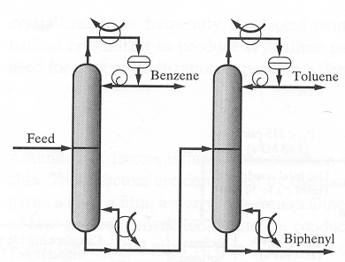
Direct Distillation Sequence

Slide 17
Column Sequences
No. of Columns
  N_{c}=P-1
    P= No. of Products
No. of Possible Column Sequences
  N_{s}=[2(P-1)]!/[P!(P-1)!]
    P= No. of Products
  P=3, N_{c}=2, N_{s}=2
  P=4, N_{c}=3, N_{s}=5
  P=5, N_{c}=4, N_{s}=14
  P=6, N_{c}=5, N_{s}=42
  P=7, N_{c}=6, N_{s}=132
No. of Possible Column Sequences Blows up!

Slide 18
How do I evaluate which is best sequence?

Slide 19
Marginal Vapor Rate
Annualized Cost~ Marginal Vapor Rate
Annualized Cost proportional to
  Reboiler Duty (Operating Cost)
  Reboiler Area (Capital Cost)
  Condenser Duty (Operating Cost)
  Condenser Area (Capital Cost)
  Diameter of Column (Capital Cost)
Vapor Rate is proportional to all of the above

Slide 20
Selecting Multiple Column Separation Trains
Minimum Cost for Separation Train will occur when you have a
  Minimum of Total Vapor Flow Rate for all columns
  R= 1.2 R_{min}
  V=D (R+1)
    V= Vapor Flow Rate
    D= Distillate Flow Rate
    R=Recycle Ratio

Slide 21
Problem
Flash
Distillation Train
Reactor

Slide 22
After Flash to 100F @ 500 psia
Recycled Reactants

Slide 23
Simplified Marginal Vapor Flow Analysis
R assumed to be similar for all columns
V~D

Slide 24
Column Design
Minimum Cost for Distillation Column will occur when you have a
  Minimum of Total Vapor Flow Rate for column
  Occurs at
    R ~ 1.2 R_{min} @ N/N_{min}=2
  V=D (R+1)
    V= Vapor Flow Rate
    D= Distillate Flow Rate (=Production Rate)
    R=Reflux Ratio

Slide 25
How To Determine the Column Pressure given coolant
Cooling Water Available at 90ºF
Distillate Can be cooled to 120ºF min.
Calculate the Bubble Pt. Pressure of Distillate Composition at 120ºF
  equals Distillate Pressure
  Bottoms Pressure = Distillate Pressure +10 psia delta P
Compute the Bubble Pt. Temp for an estimate of the Bottoms Composition at Distillate Pressure
  Gives Bottoms Temperature
P > Atm, Pressure generated by system.
For Vacuum, how is it that generated?
Not Near Critical Point for mixture

Slide 26
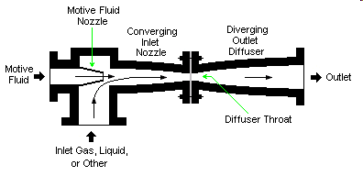
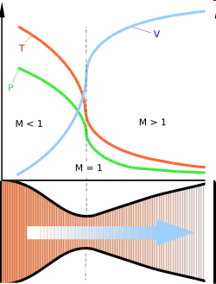

Steam Ejector Generates the Vacuum.
High Pressure
High Velocity
Steam
Velocity > Mach 1
Bernoulli’s Equation
Vacuum

Slide 27
Design Issues
Packing vs Trays
Column Diameter from flooding consideration
  Trays, D_{T}=[(4G)/((f U_{flood} π(1-A_{down}/A_{T})ρ_{G})]^{1/2} eq. 14.11
    U_{flood}= f(dimensionless density difference), f = 0.75-0.85 eq. 14.12
  Packed, D_{T} =[(4G)/((f U_{flood} πρ_{G})]^{1/2} eq. 14.14
    U_{flood}= f(flow ratio), f = 0.75-0.85 eq. 14.15
Column Height
  N_{min}=log[(d_{LK}/b_{LK})(b_{HK}/d_{HK})]/log[α_{LK,HK}] eq. 14.1
  N=N_{min}/ε
    Tray Height = N*H_{tray}
    Packed Height = N_{eq}*HETP
      HETP(height equivalent of theoretical plate)
      HETP_{random} = 1.5 ft/in*D_{p} eq. 14.9
Tray Efficiency, ε = f(viscosity_{liquid} * α_{LK,HK}) Fig 14.3
Pressure Drop
    Tray, ΔP=ρ_{L}g h_{L-wier} N
    Packed, ΔP=Packed bed

Slide 28
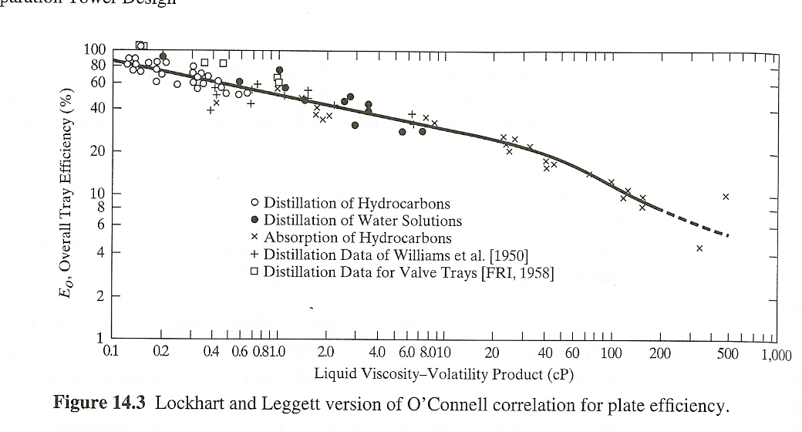
Tray Efficiency
μ_{L *} α_{LK,HK}

Slide 29
Costing

Slide 30
Column Costs
Column – Material of Construction gives ρ_{metal}
  Pressure Vessel C_{p}= F_{M}C_{v}(W)+C_{Platform}
Reboiler C_{B} α Area_{HX}
Condenser C_{B} α Area_{HX}
Pumping Costs – feed, reflux, reboiler
  Work = Q*ΔP
Tanks
  Surge tank before column, reboiler accumulator (sometimes longer (empty) tower), condensate accumulator

Slide 31
Problem
Methanol-Water Distillation
Feed
  10 gal/min
  50/50 (mole) mixture
Desired to get
  High Purity MeOH in D
  Pure Water in B

Slide 32
Simulator Methods - Aspen
Start with simple distillation method
  DSTWU – Winn-Underwood-Gilliland Method
    Min # stages, R_{min} – Fenske-Underwood
    Min # stages vs R - Gilliland
  Distil – short cut Edmister Method
Then go to more complicated one for sizing purposes
  RadFrac – rigorous method
  Sizing in RadFrac

Slide 33
Eric Carlson’s Recommendations
Figure 1
Non-electrolyte
See Figure 2
Polar
E?
Electrolyte
Electrolyte NRTL
Or Pizer
Real
Peng-Robinson,
Redlich-Kwong-Soave,
Lee-Kesler-Plocker
All
Non-polar
R?
Chao-Seader,
Grayson-Streed or
Braun K-10
Polarity
R?
Real or
pseudocomponents
Pseudo & Real
P?
P?
Pressure
Vacuum
E?
Braun K-10 or ideal
Electrolytes

Slide 34
Yes
NRTL, UNIQUAC
and their variances
Figure 2
Yes
LL?
WILSON, NRTL,
UNIQUAC and
their variances
P < 10 bar
ij?
No
(See also
Figure 3)
Yes
UNIFAC LLE
P?
LL?
No
Polar
Non-electrolytes
No
UNIFAC and its
extensions
Schwartentruber-Renon
PR or SRK with WS
PR or SRK with MHV2
LL?
Liquid/Liquid
Yes
P?
Pressure
P > 10 bar
ij?
ij?
No
PSRK
PR or SRK with MHV2
Interaction Parameters
Available

Slide 35
Wilson, NRTL, UNIQUAC,
or UNIFAC with special EOS
for Hexamers
Figure 3
Hexamers
Yes
DP?
Wilson, NRTL, UNIQUAC,
UNIFAC with Hayden O’Connell
or Northnagel EOS
Dimers
VAP?
Wilson
NRTL
UNIQUAC
UNIFAC
Wilson, NRTL,
UNIQUAC, or UNIFAC*
with ideal Gas or RK EOS
No
VAP?
Vapor Phase Association
UNIFAC* and its Extensions
DP?
Degrees of Polymerizatiom

Slide 36
Distillation Problems
Multi-component Distillation
  Selection of Column Sequences
  Selection of tray for side stream
Azeotropy
  Overcoming it to get pure products
Heat Integration
  Decreasing the cost of separations

